Slide 1
Copyright © 2022 <PixelHub>
Permission is hereby granted, free of charge, to any person obtaining a copy of this slides and associated documentation files (the “Slides”), to deal in the Slides without restriction, including without limitation the rights to use, copy, modify, merge, publish, distribute, sublicense, and/or sell copies of the Slides, and to permit persons to whom the Slides is furnished to do so, subject to the following conditions:
The above copyright notice and this permission notice shall be included in all copies or substantial portions of the Slides.
THE SLIDES IS PROVIDED “AS IS”, WITHOUT WARRANTY OF ANY KIND, EXPRESS OR IMPLIED, INCLUDING BUT NOT LIMITED TO THE WARRANTIES OF MERCHANTABILITY, FITNESS FOR A PARTICULAR PURPOSE AND NONINFRINGEMENT. IN NO EVENT SHALL THE AUTHORS OR COPYRIGHT HOLDERS BE LIABLE FOR ANY CLAIM, DAMAGES OR OTHER LIABILITY, WHETHER IN AN ACTION OF CONTRACT, TORT OR OTHERWISE, ARISING FROM, OUT OF OR IN CONNECTION WITH THE SLIDES OR THE USE OR OTHER DEALINGS IN THE SLIDES.

Slide 3
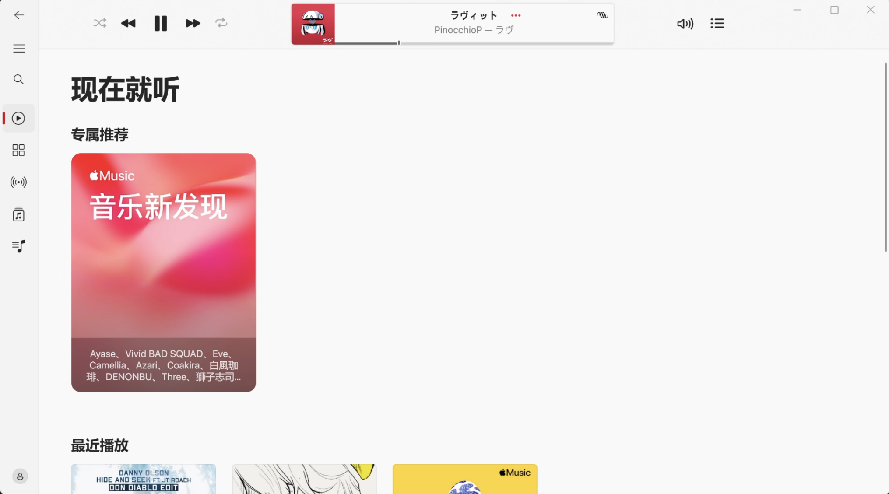
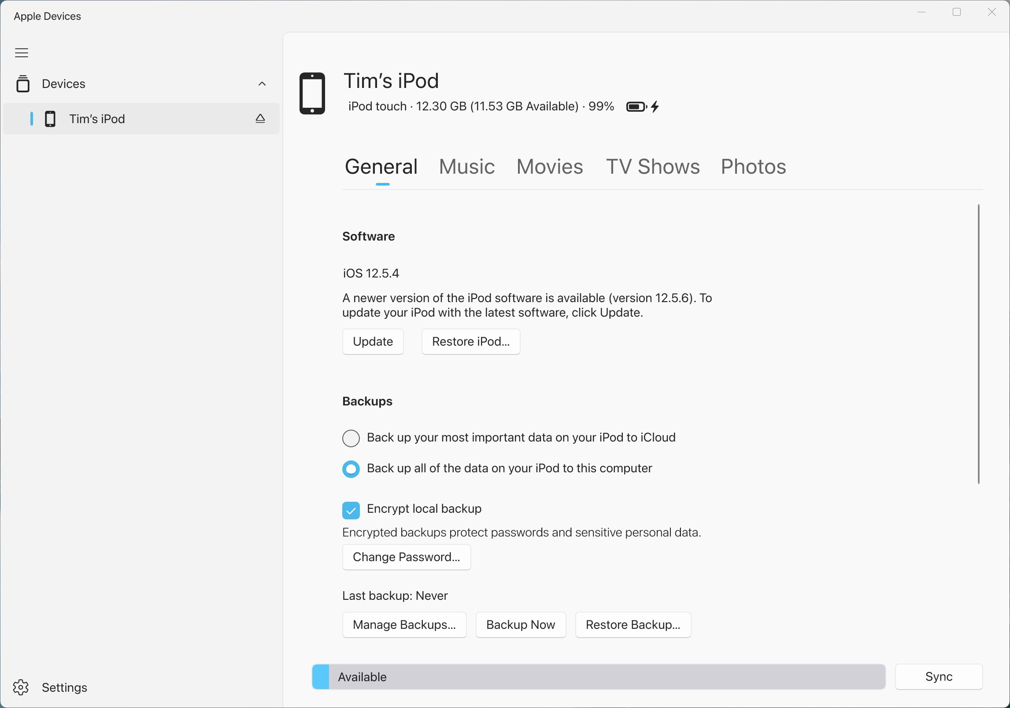
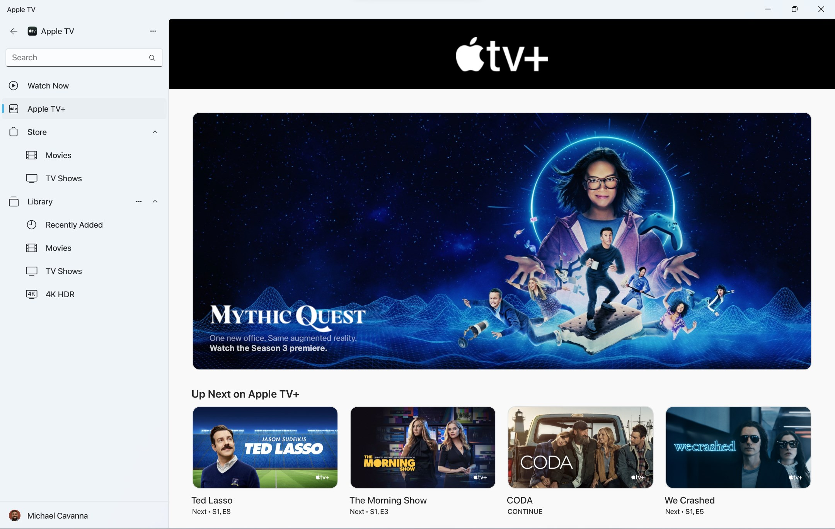
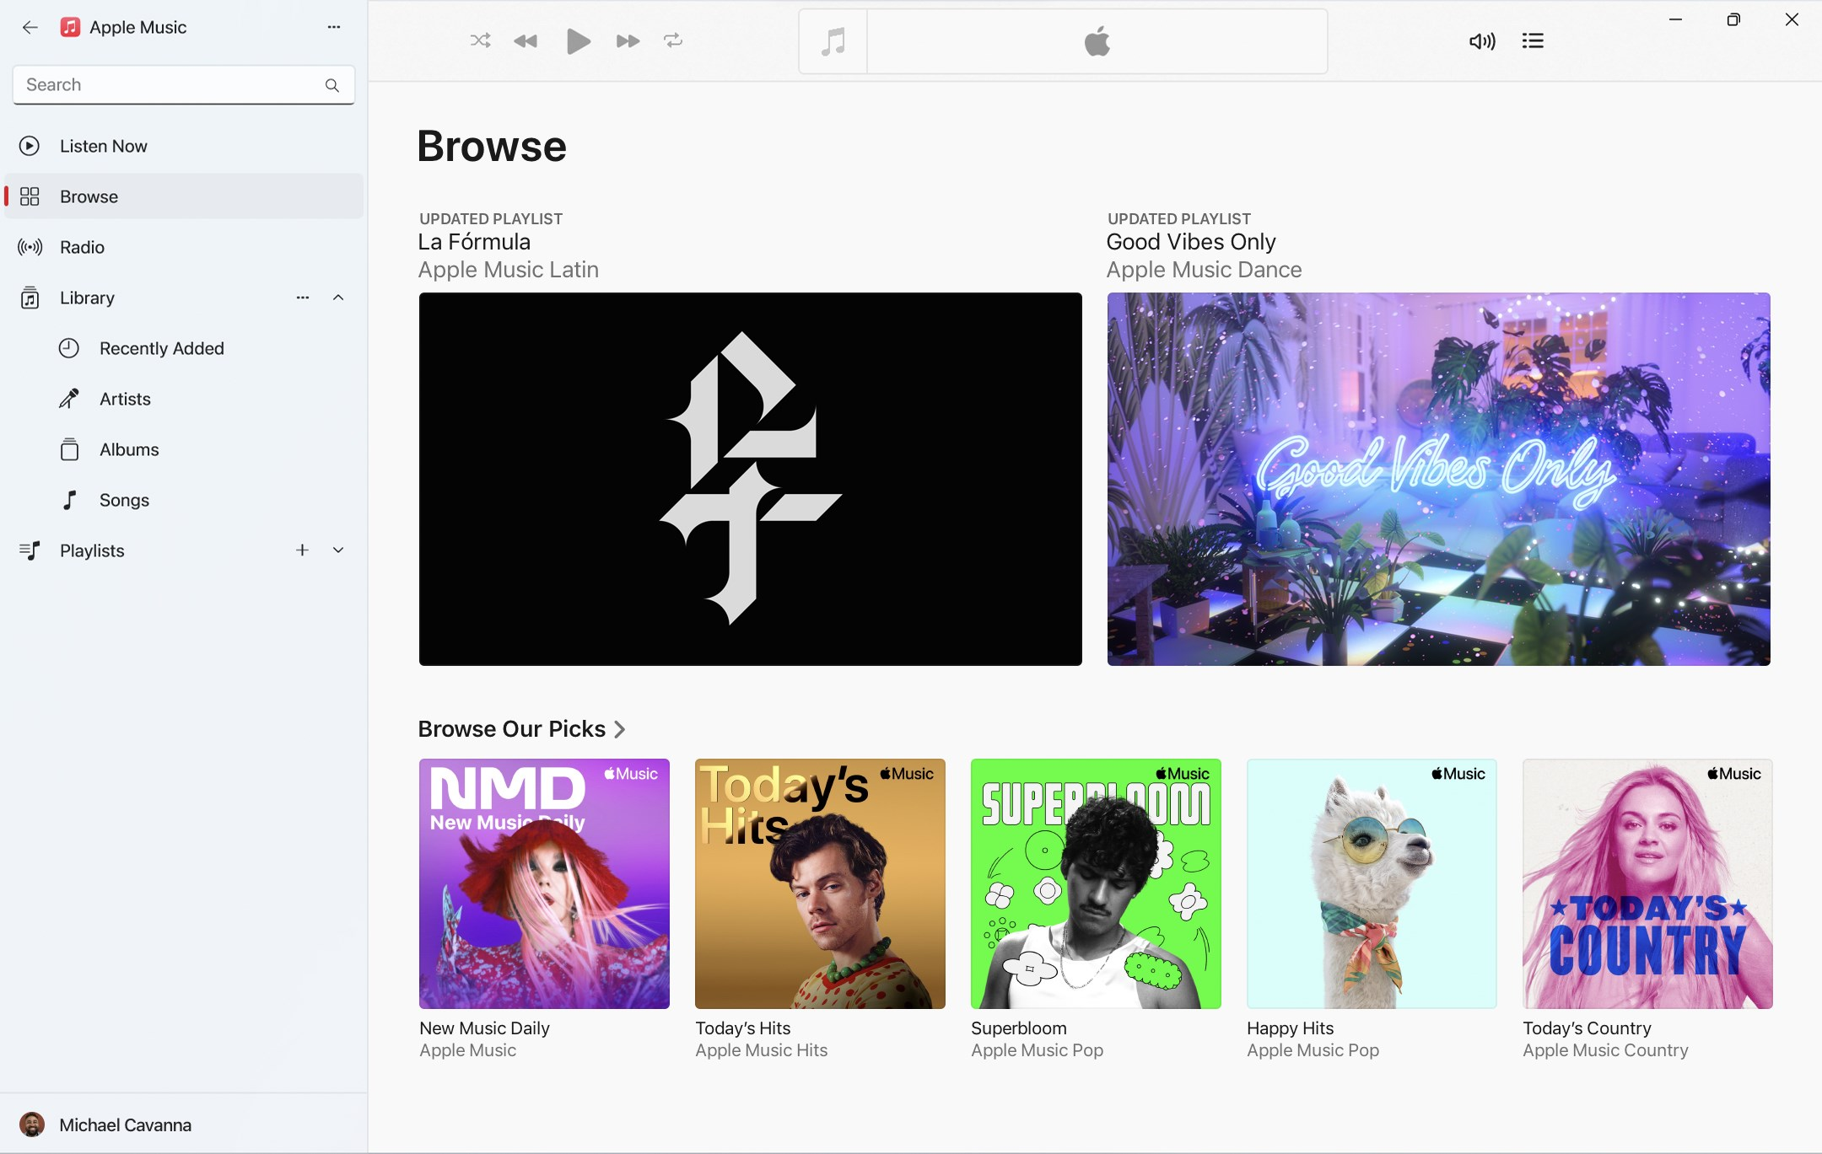

Slide 10
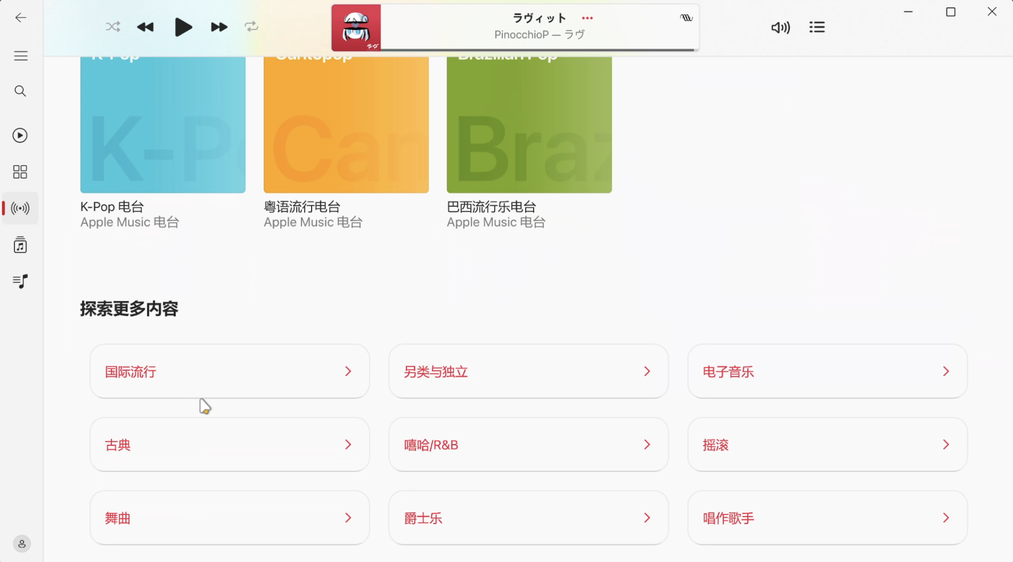
Conclusion
新的三件套拆分了iTunes的功能并不能与之共存
New Tri-suite splits iTunes features and doesn't work with it
Apple Music Preview已经相当完善可以使用但与稳定的macOS端仍有差距
Apple Music Preview has been quite perfect to use but there is still a gap with the stable macOS client
建议新用户注册Apple ID免费体验一个月
It is recommended that new users sign up for an Apple ID to start a one 1-month trial
系统要求:
Requirements:
System Region: US
X64 arch PC running Windows 11 version 226210.0 or higher

Slide 11
Conclusion
新的三件套拆分了iTunes的功能并不能与之共存
New Tri-suite splits iTunes features and doesn't work with it
Apple Music Preview已经相当完善可以使用但与稳定的macOS端仍有差距
Apple Music Preview has been quite perfect to use but there is still a gap with the stable macOS client
建议新用户注册Apple ID免费体验一个月
It is recommended that new users sign up for an Apple ID to start a one 1-month trial
系统要求:
Requirements:
System Region: US
X64 arch PC running Windows 11 version 226210.0 or higher

Slide 12



Resources
视频及幻灯片中出现的商标均为相应公司的商标和注册商标
All trademarks appearing in the video and slides are trademarks and registered trademarks of the respective companies
“得意黑”开源字体 (OFL-1.1) -来自 oooooohmygosh 及其团队
”Smiley Sans" open font (OFL-1.1) - by ooooooohmygosh and his team
https://github.com/atelier-anchor/smiley-sans
https://github.com/atelier-anchor/smiley-sans/blob/main/LICENSE
示例图片来自对应软件的微软商店简介页
Example images come from the Microsoft Store profile page of the corresponding software
https://apps.microsoft.com/store/detail/apple-music-preview/9PFHDD62MXS1
https://apps.microsoft.com/store/detail/apple-tv-preview/9NM4T8B9JQZ1
https://apps.microsoft.com/store/detail/apple-devices-preview/9NP83LWLPZ9K
Music：Formed by Glaciers – Ember – Kubbi (CC BY–SA 3.0)
https://kubbimusic.com/
https://creativecommons.org/licenses/by-sa/3.0/

